Slide 1
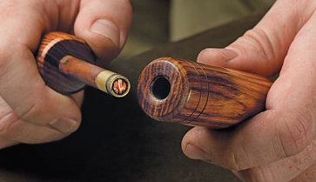
Simple Example: Fire Piston
Importance: Operates on the same principal as a diesel engine (the type of engine I am simulating)
Cap
The primitive Fire Piston is a traditional fire starting tool used by the South-East Asian Islanders. It rapidly compresses air molecules inside its cylinder, making them hot enough to cause combustion (autoignition temperature). With a single push, tinder placed in the end of the shaft ignites.
Rod
Gasket
Tinder Cup
Bore
Body
u is the energy per mass with units of joule per kilogram
Conservation of Energy:
v is the specific volume with units of m³ per kilogram
P is the pressure with units of pascal (same as Joule per m³)
As the volume decreases energy increases, using specific heat, c_{v} , we can bring temperature into the equation.
The pressure, P , is increasing as we compress the piston, therefore we need an additional equation to model the system.
Ideal Gas Law:
T is the temperature with units of Kelvin
W is the molecular weight with units of kilogram per mole
R_{u} is the universal gas constant with units of joule per mole kelvin
Note: In a reacting mixture, the average molecular weight is not constant. Molecules can break apart or combine.
Using chain rule:

